Slide 1
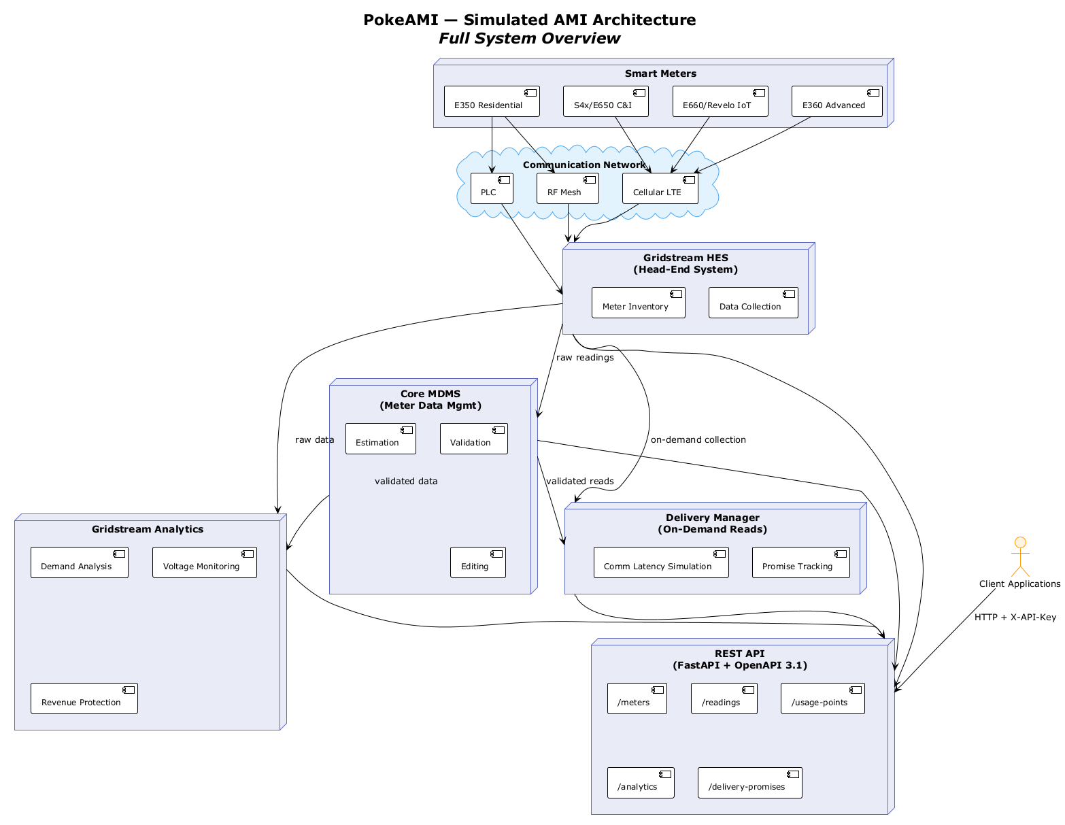
PokeAMI — Simulated AMI Architecture
Smart Meters
E350 Residential
S4x/E650 C&I
E660/Revelo IoT
E360 Advanced
Communication Network
PLC
RF Mesh
Cellular LTE
Gridstream HES
[(Head-End System)]
Meter Inventory
Data Collection
Core MDMS
[(Meter Data Mgmt)]
raw readings
Estimation
Validation
on-demand collection
raw data
Delivery Manager
[(On-Demand Reads)]
Gridstream Analytics
validated reads
Demand Analysis
Voltage Monitoring
validated data
Editing
Comm Latency Simulation
Promise Tracking
Client Applications
HTTP + X-API-Key
REST API
[(FastAPI + OpenAPI 3.1)]
Revenue Protection
/meters
/readings
/usage-points
/analytics
/delivery-promises

